Slide 1




Relational Databases
Creating MySQL DB, SQL CRUD
MySQL
Georgi Novakov
Develop Soft CEO
Software University
http://softuni.bg

Slide 2



Table of Contents
Databases Overview
Relational Databases
MySQL Overview
Creating DB Tables
Introduction to SQL
SELECT, WHERE, JOIN
INSERT, UPDATE, DELETE

Slide 3
Databases Overview
What is a database
NoSQL databases
Relational Databases
SQL
Notes:
A database is an organized collection of data

Slide 4
NoSQL Database Types
Document databases pair each key with a complex data structure known as a document. Documents can contain many different key-value pairs, or key-array pairs, or even nested documents.
Graph stores are used to store information about networks of data, such as social connections. Graph stores include Neo4J and Giraph.
Key-value stores are the simplest NoSQL databases. Every single item in the database is stored as an attribute name (or 'key'), together with its value. Examples of key-value stores are Riak and Berkeley DB. Some key-value stores, such as Redis, allow each value to have a type, such as 'integer', which adds functionality.
Wide-column stores such as Cassandra and HBase are optimized for queries over large datasets, and store columns of data together, instead of rows.
Notes:
A database is an organized collection of data

Slide 5
Relational Databases
The relational database was invented by E. F. Codd at IBM in 1970.
A relational database is a collection of data items organized as a set of formally-described tables
Application program interface to a relational database is the structured query language (SQL)
Vendors: Oracle DB, Infomix DB, DB2, MS SQL, MySQL, PostgreSQL
https://en.wikipedia.org/wiki/Comparison_of_relational_database_management_systems
Notes:
A database is an organized collection of data

Slide 6
NoSQL vs. SQL
 | SQL Databases | NOSQL Databases
Types | One type (SQL database) with minor variations | Many different types including key-value stores, document databases, wide-column stores, and graph databases
Development History | Developed in 1970s to deal with first wave of data storage applications | Developed in late 2000s to deal with limitations of SQL databases, especially scalability, multi-structured data, geo-distribution and agile development sprints
Examples | MySQL, Postgres, Microsoft SQL Server, Oracle Database | MongoDB, Cassandra, HBase, Neo4j, Couchbase, CouchDB, Redis
Data Storage Model | Individual records (e.g., 'employees') are stored as rows in tables, with each column storing a specific piece of data about that record (e.g., 'manager,' 'date hired,' etc.), much like a spreadsheet. Related data is stored in separate tables, and then joined together when more complex queries are executed. For example, 'offices' might be stored in one table, and 'employees' in another. When a user wants to find the work address of an employee, the database engine joins the 'employee' and 'office' tables together to get all the information necessary. | Varies based on database type. For example, key-value stores function similarly to SQL databases, but have only two columns ('key' and 'value'), with more complex information sometimes stored as BLOBs within the 'value' columns. Document databases do away with the table-and-row model altogether, storing all relevant data together in single 'document' in JSON, XML, or another format, which can nest values hierarchically.
Schemas | Structure and data types are fixed in advance. To store information about a new data item, the entire database must be altered, during which time the database must be taken offline. | Typically dynamic, with some enforcing data validation rules. Applications can add new fields on the fly, and unlike SQL table rows, dissimilar data can be stored together as necessary. For some databases (e.g., wide-column stores), it is somewhat more challenging to add new fields dynamically.
Scaling | Vertically, meaning a single server must be made increasingly powerful in order to deal with increased demand. It is possible to spread SQL databases over many servers, but significant additional engineering is generally required, and core relational features such as JOINs, referential integrity and transactions are typically lost. | Horizontally, meaning that to add capacity, a database administrator can simply add more commodity servers or cloud instances. The database automatically spreads data across servers as necessary.
Development Model | Mix of open-source (e.g., Postgres, MySQL) and closed source (e.g., Oracle Database, Informix, MS SQL) | Open-source
Supports Transactions | Yes, updates can be configured to complete entirely or not at all | In certain circumstances and at certain levels (e.g., document level vs. database level)
Data Manipulation | Specific language using Select, Insert, and Update statements, e.g. SELECT fields FROM table WHERE… | Through object-oriented APIs

Slide 7
MySQL – Overview

Slide 8
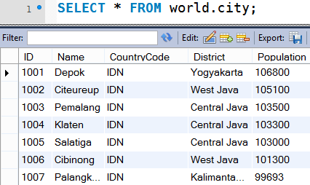

What is MySQL?
MySQL
MySQL is open-source DB server (RDBMS)
World's most-popular open-source database
Used to power web sites and small apps
Free and paid editions
Community Server, Enterprise, Cluster CGE
MariaDB
Community-driven fork of the MySQL server

Slide 9
MySQL Installation – Linux (Ubuntu)
MySQL
sudo apt-get update
sudo apt-get install mysql-server
sudo mysql_secure_installation
sudo mysql_install_db
https://www.digitalocean.com/community/tutorials/how-to-install-mysql-on-ubuntu-14-04
PHPMyAdmin
sudo apt-get update
sudo apt-get install phpmyadmin
https://www.digitalocean.com/community/tutorials/how-to-install-and-secure-phpmyadmin-on-ubuntu-14-04

Slide 10
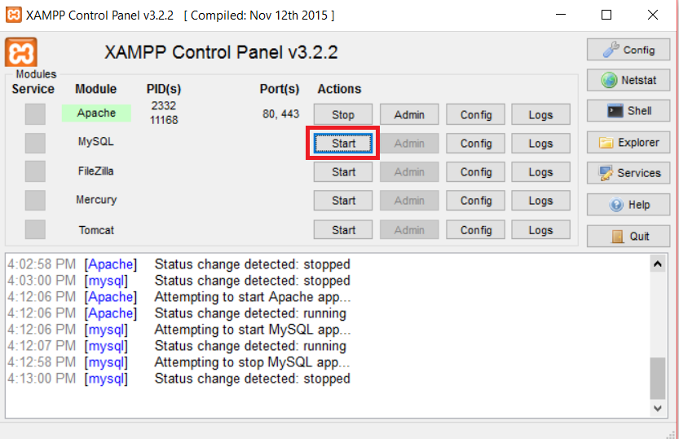
MySQL Installation – Windows
XAMPP -An easy to install Apache distribution containing MySQL, PHP, and Perl
https://www.google.bg/search?q=XAMPP&oq=XAMPP&aqs=chrome..69i57j0l5.164j0j7&sourceid=chrome&ie=UTF-8

Slide 11
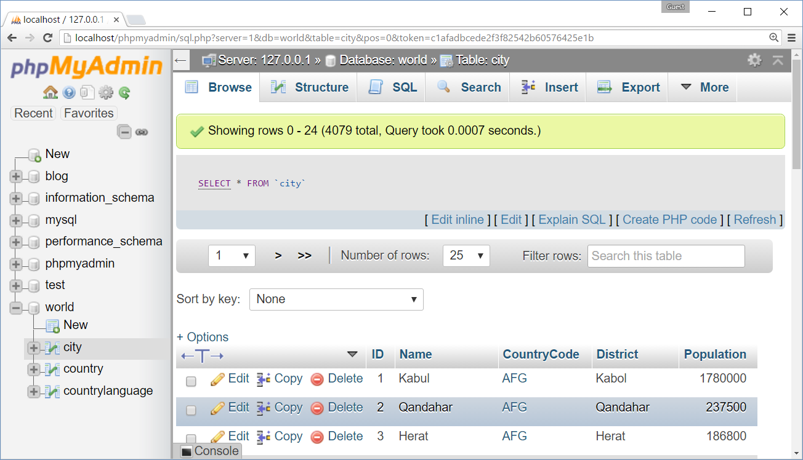
phpMyAdmin – Web Based MySQL Admin

Slide 12
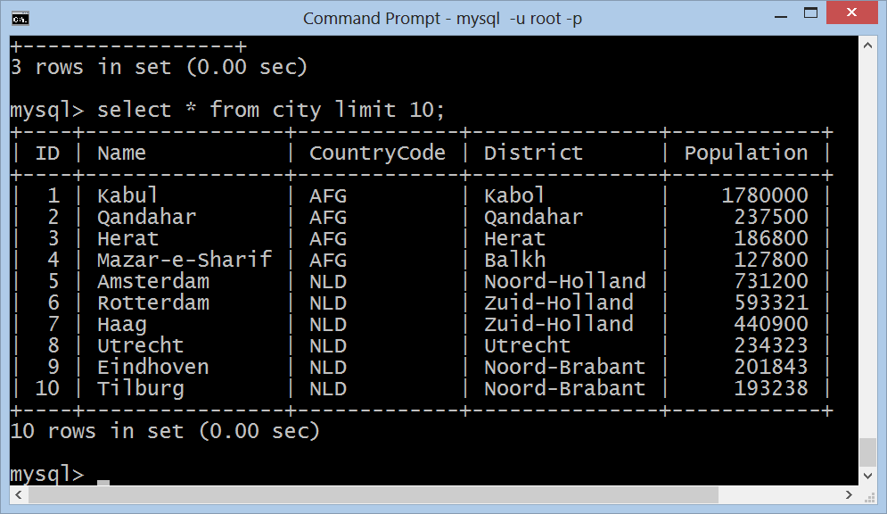
MySQL Console Client
mysql –u root -p

Slide 13
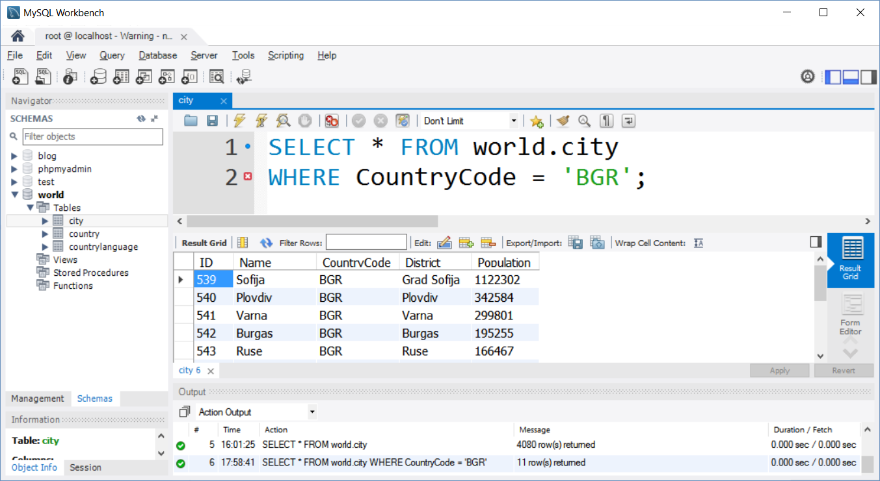
MySQL Workbench – Free Desktop Admin

Slide 14
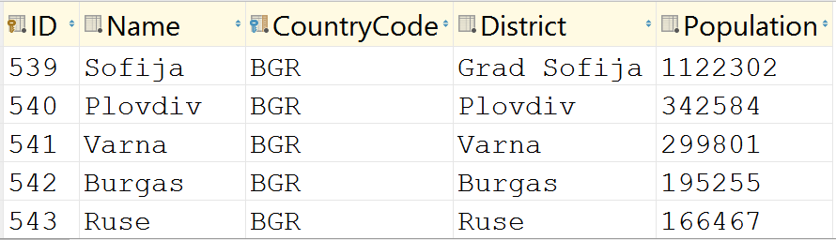
Databases and Tables
Databases (DB schemas)
Hold set of tables with relationships
Tables hold data organized in rows and columns
Table column
Table row

Slide 15
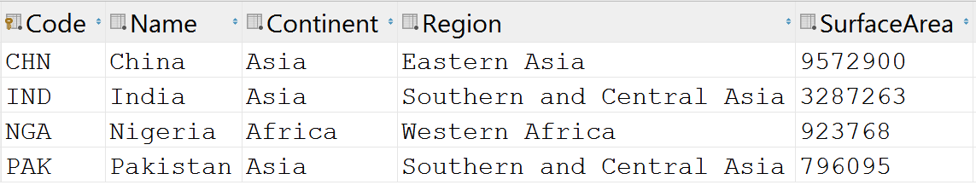

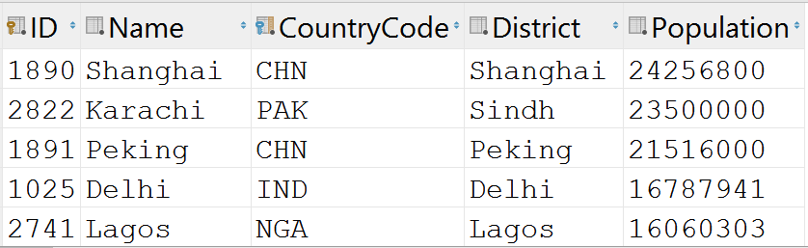
Relationships
Primary key column
Foreign key column
Relationship (foreign key)

Slide 16
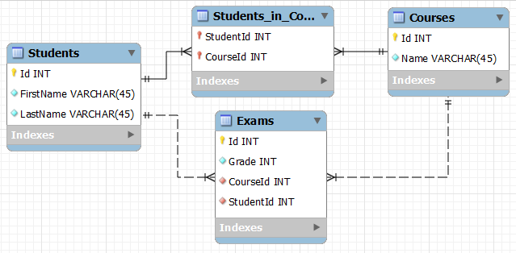
Database Schema
Database schema defines the table structure and relationships
Visualized as database diagram (E/R diagram)

Slide 17
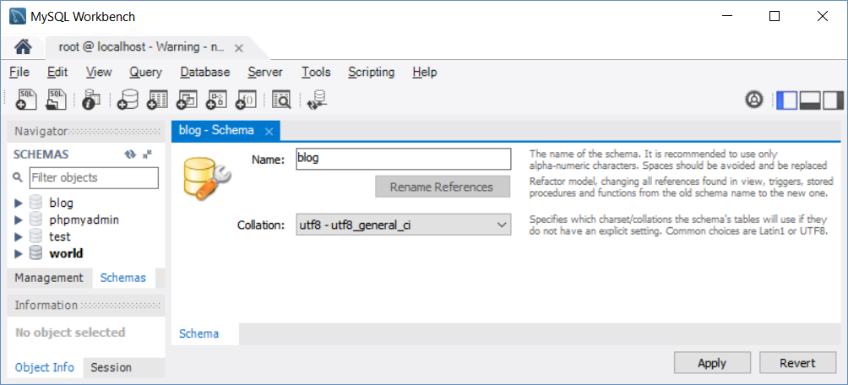
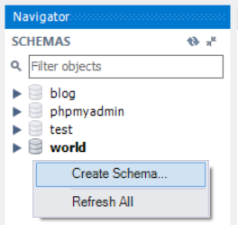
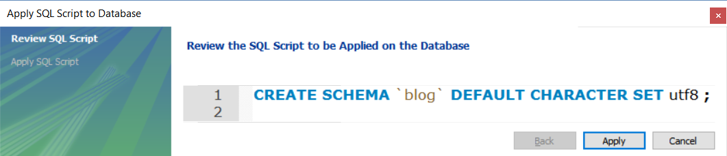
Create a Database in MySQL
Prefer UTF-8 based collation

Slide 18
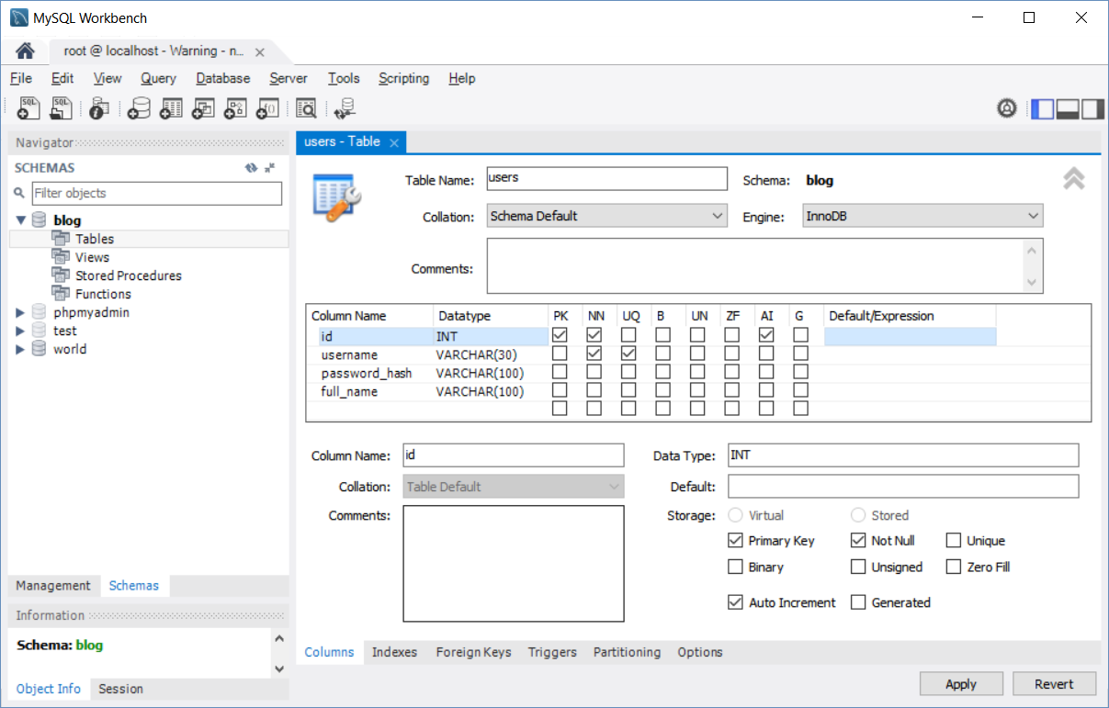
Create a Table in MySQL Database

Slide 19
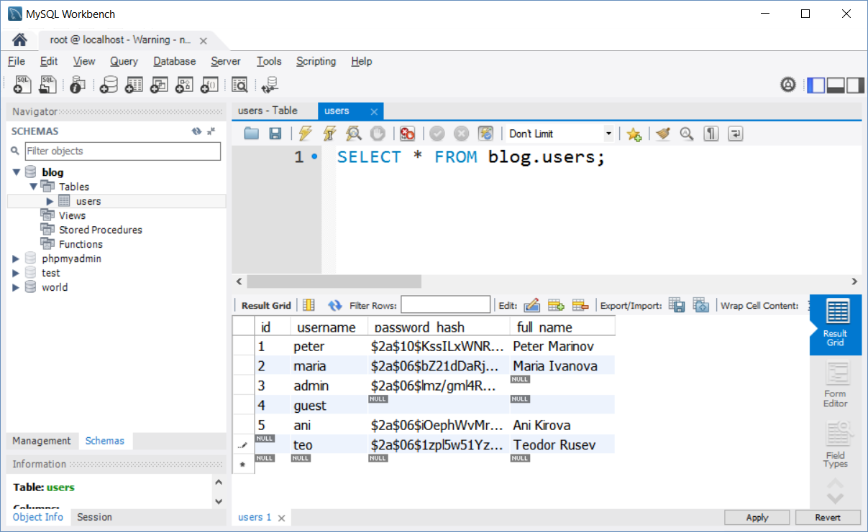
Insert Data Rows in a Table

Slide 20
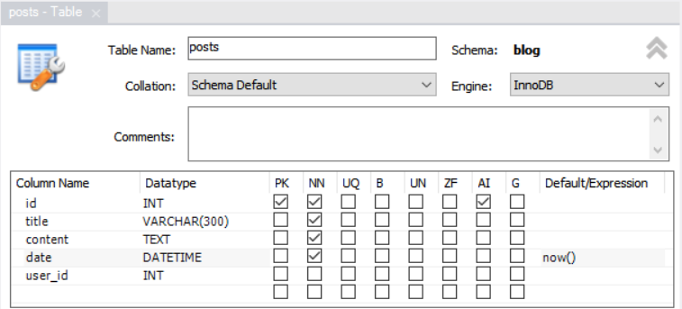
Create Related Table (with Relationship)

Slide 21
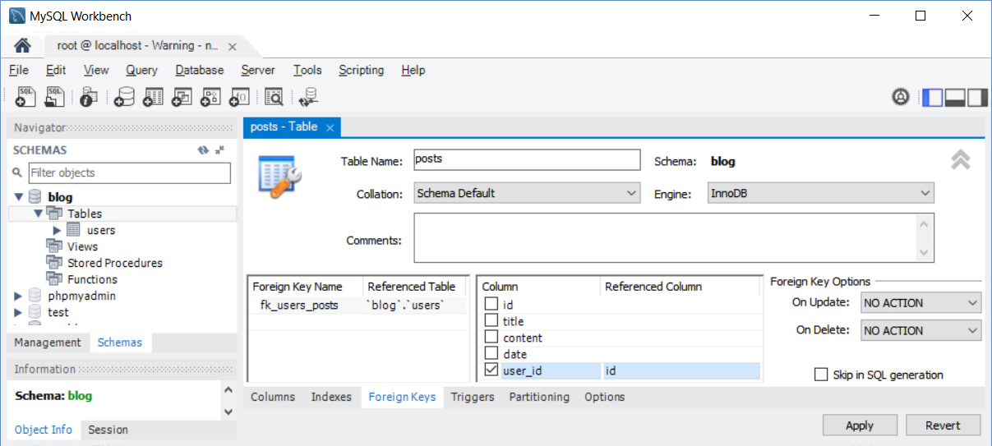
Create Foreign Key Relationship

Slide 22
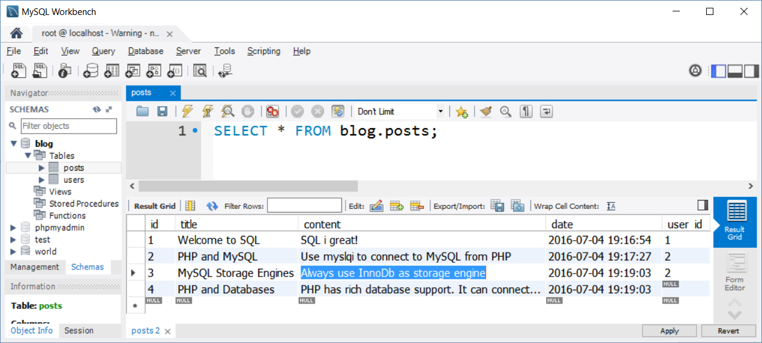
Insert Related Rows in the Second Table

Slide 23
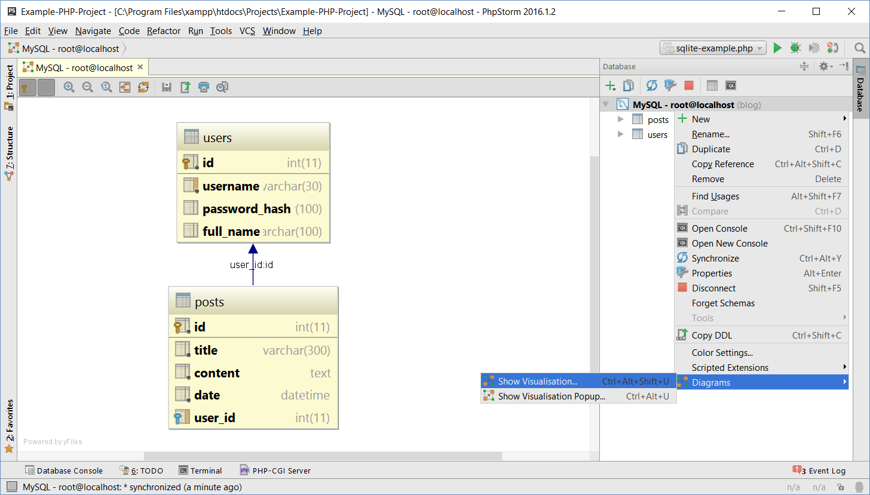
Blog Database in MySQL – DB Diagram

Slide 24
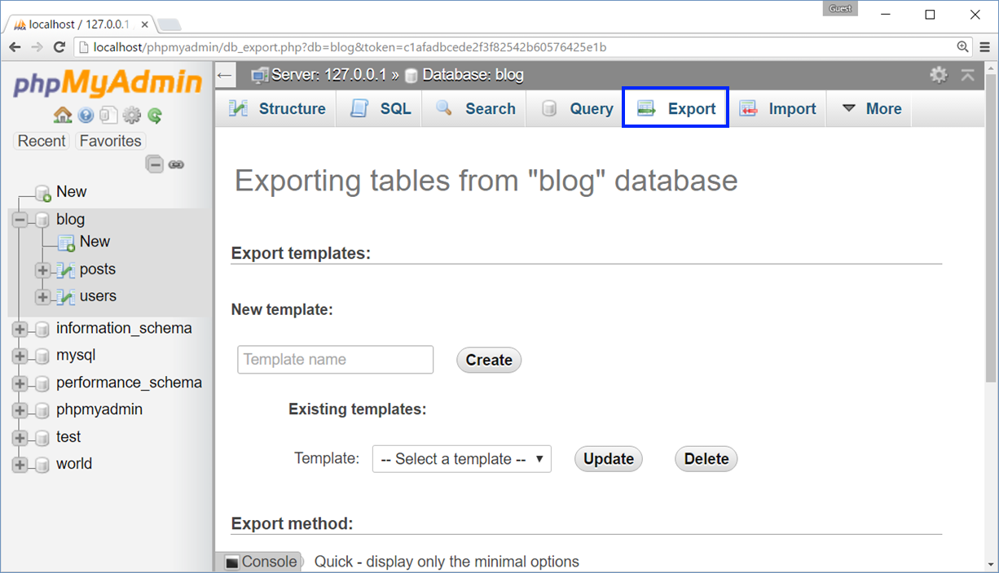
Backup Database as SQL Script
Backup database as SQL script using phpMyAdmin

Slide 25
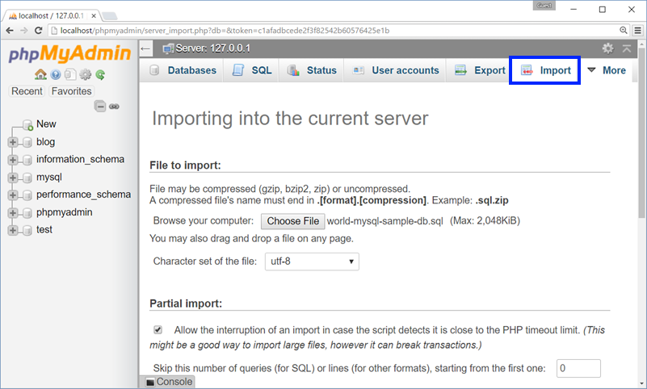
Restore Database from SQL Script
Restore database from SQL script using phpMyAdmin

Slide 26
Creating Tables in MySQL
Create table users(id, username, password_hash, full_name). Use a tool of your choice.
Insert some sample data in the table.
Create table posts(id, title, content, date, user_id).
Create foreign key from posts to users.
Insert some sample data.
Live Exercise (Lab)

Slide 27
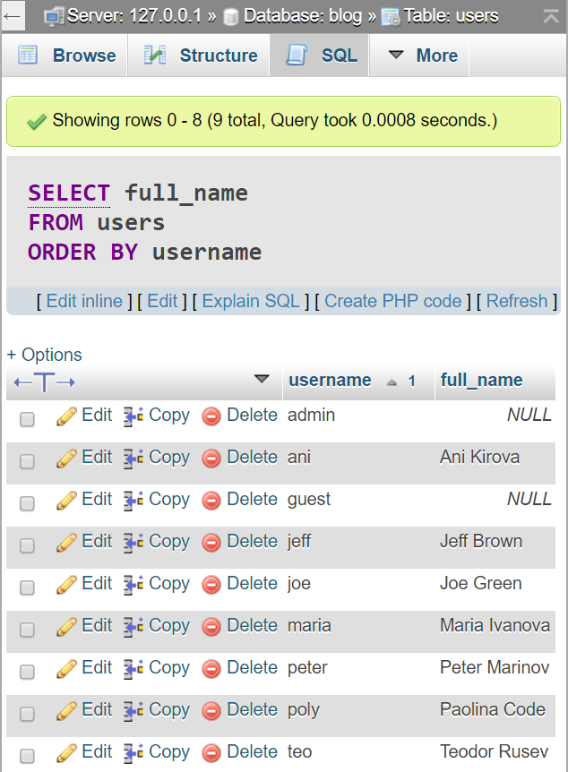



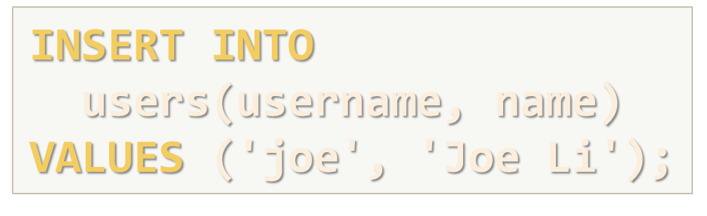


SQL – Introduction

Slide 28
SQL Language
SELECT
WHERE (filtering)
JOIN (joining tables)
GROUP BY (grouping)
INSERT
UPDATE
DELETE

Slide 29
SQL: SELECT, WHERE, ORDER BY
SELECT
WHERE
ORDER BY
SELECT username, full_name
FROM users
SELECT * FROM users
SELECT * FROM users
WHERE full_name LIKE 'M%'
OR full_name LIKE 'P%'
SELECT * FROM users
WHERE username = 'teo'
SELECT * FROM users
ORDER BY full_name DESC
LIMIT 3
SELECT * FROM users
ORDER BY username

Slide 30
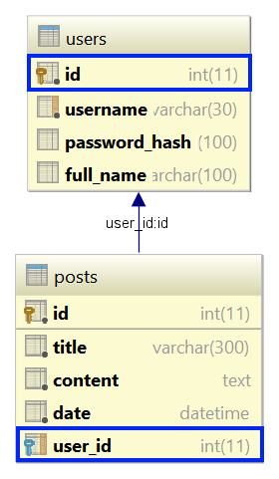
SQL: Join Tables
Join users with posts tables in SQL SELECT
SELECT *
FROM posts JOIN users
ON posts.user_id = users.id
SELECT p.title AS post,
u.username AS author
FROM posts p JOIN users u
ON p.user_id = u.id

Slide 31
SQL: INSERT
Insert a new post (id and date will be auto-generated)
Insert a few new users without passwords
INSERT INTO posts(title, content, user_id)
VALUES ('New Title', 'New post content', 3)
INSERT INTO users(username, full_name) VALUES
('joe', 'Joe Green'),
('jeff', 'Jeff Brown'),
('poly', 'Paolina Code')

Slide 32
SQL: UPDATE
Update existing post → change title
Update existing post → change date
UPDATE posts
SET title = 'Title Updated!'
WHERE id = 2;
UPDATE posts
SET date = STR_TO_DATE('31-12-2016', '%d-%m-%Y')
WHERE YEAR(date) = 2016;

Slide 33
SQL: DELETE
Delete existing post
Delete all posts from user joe
DELETE FROM posts
WHERE id = 6;
DELETE FROM posts
WHERE user_id =
(SELECT id FROM users
WHERE username = 'joe');

Slide 34
SQL Commands
Write SQL INSERT to create a new user (username 'pesho', password '$xyz', name 'Peter Ivanov').
Write SQL UPDATE to change user 'pesho' to 'pepi'.
Write SQL SELECT to show all users that start with 'p'.
Write SQL INSERT to create a new post from user 'pepi'.
Write SQL SELECT to show all posts from user 'pepi'.
Write SQL DELETE to remove all posts from user 'pepi'.
Live Exercise (Lab)

Slide 35

Summary
MySQL is a relational database (RDBMS)
MySQL DB holds data in tables
Tables can have relationships
SQL is standard language for most databases
Query data: SQL SELECT, WHERE + table joins
Modify data: SQL UPDATE, DELETE, INSERT

Slide 36
https://softuni.bg/courses/software-technologies

Slide 37






Free Trainings @ Software University
Software University Foundation – softuni.org
Software University – High-Quality Education, Profession and Job for Software Developers
softuni.bg
Software University @ Facebook
facebook.com/SoftwareUniversity
Software University @ YouTube
youtube.com/SoftwareUniversity
Software University Forums – forum.softuni.bg

